Slide 1
Project # 2 Cardiovascular Disease dataset Presence or absence of cardiovascular disease. cardio_train.csv https://www.kaggle.com/datasets/sulianova/cardiovascular-disease-dataset Walmart Dataset Walmart Store Sales Prediction - Regression Problem This is the historical data that covers sales from 2010-02-05 to 2012-11-01, in the file Walmart_Store_sales. Walmart.csv https://www.kaggle.com/datasets/yasserh/walmart-dataset?resource=download
Thursday, September 26, 2024
William Aromando
Dan Becker
Joanne Donohue
Vivin Rajagopalan
Aaron Swan

Slide 2
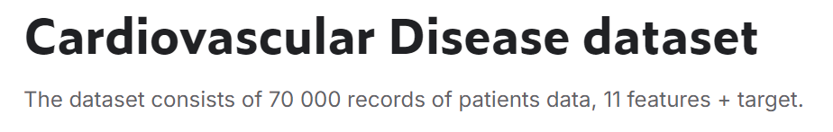
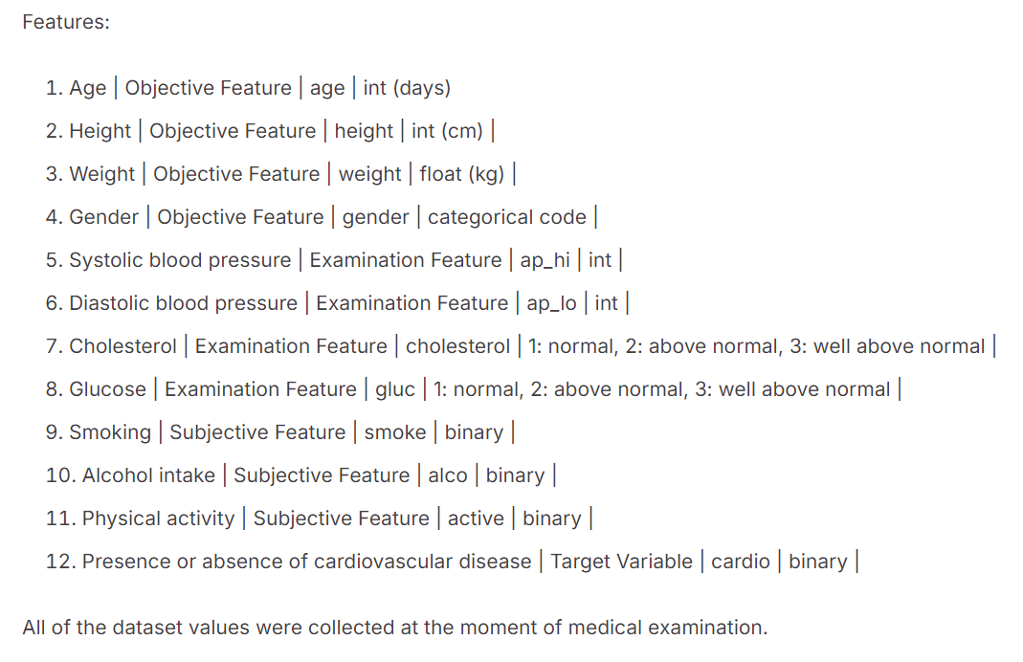
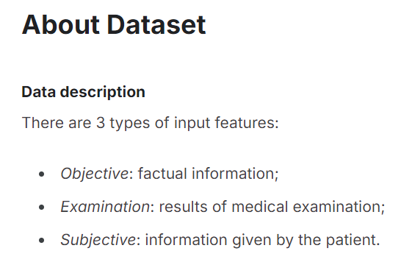

Slide 3
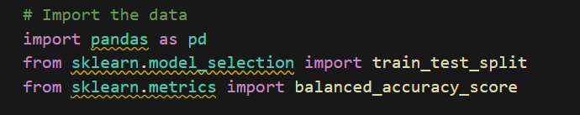
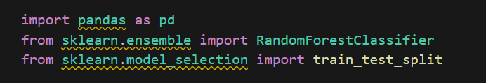
Checking Balanced Accuracy Score
Balance accuracy score Test set 0.72 Training set 0.731
Logistic Regression Model (Accuracy) Score 0.999 Accuracy of the model with testing data Score 0.724
The initial attempt was made to pass the data through some of the previous assignments from class.
While the Logistic Regression Model showed an (Accuracy) Score of 0.999, most of the results Scored about the same around 0.72

Slide 4
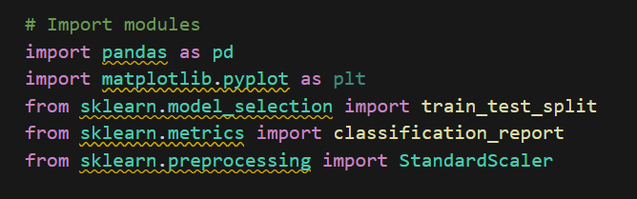
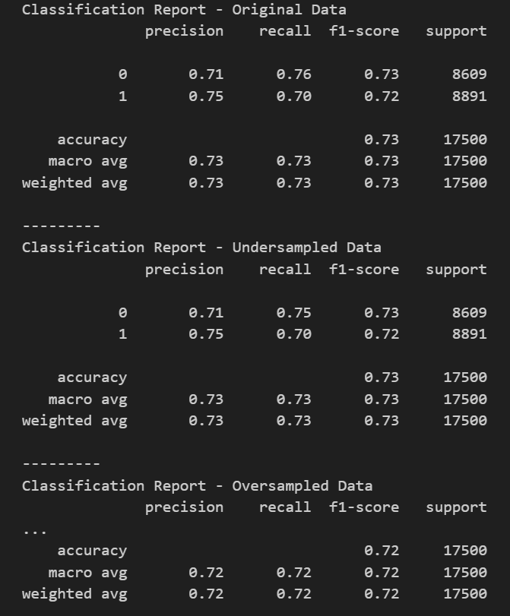
Random Forest Classier model
Under Sample and Original Accuracy both 0.73 Oversampled 0.72
Cluster centroids model did not complete running
SMOTE and SMOTEENN 0.72
Presence or absence of cardiovascular disease
| Target Variable | cardio | binary | cardio_train.csv

Slide 5
